Slide 1

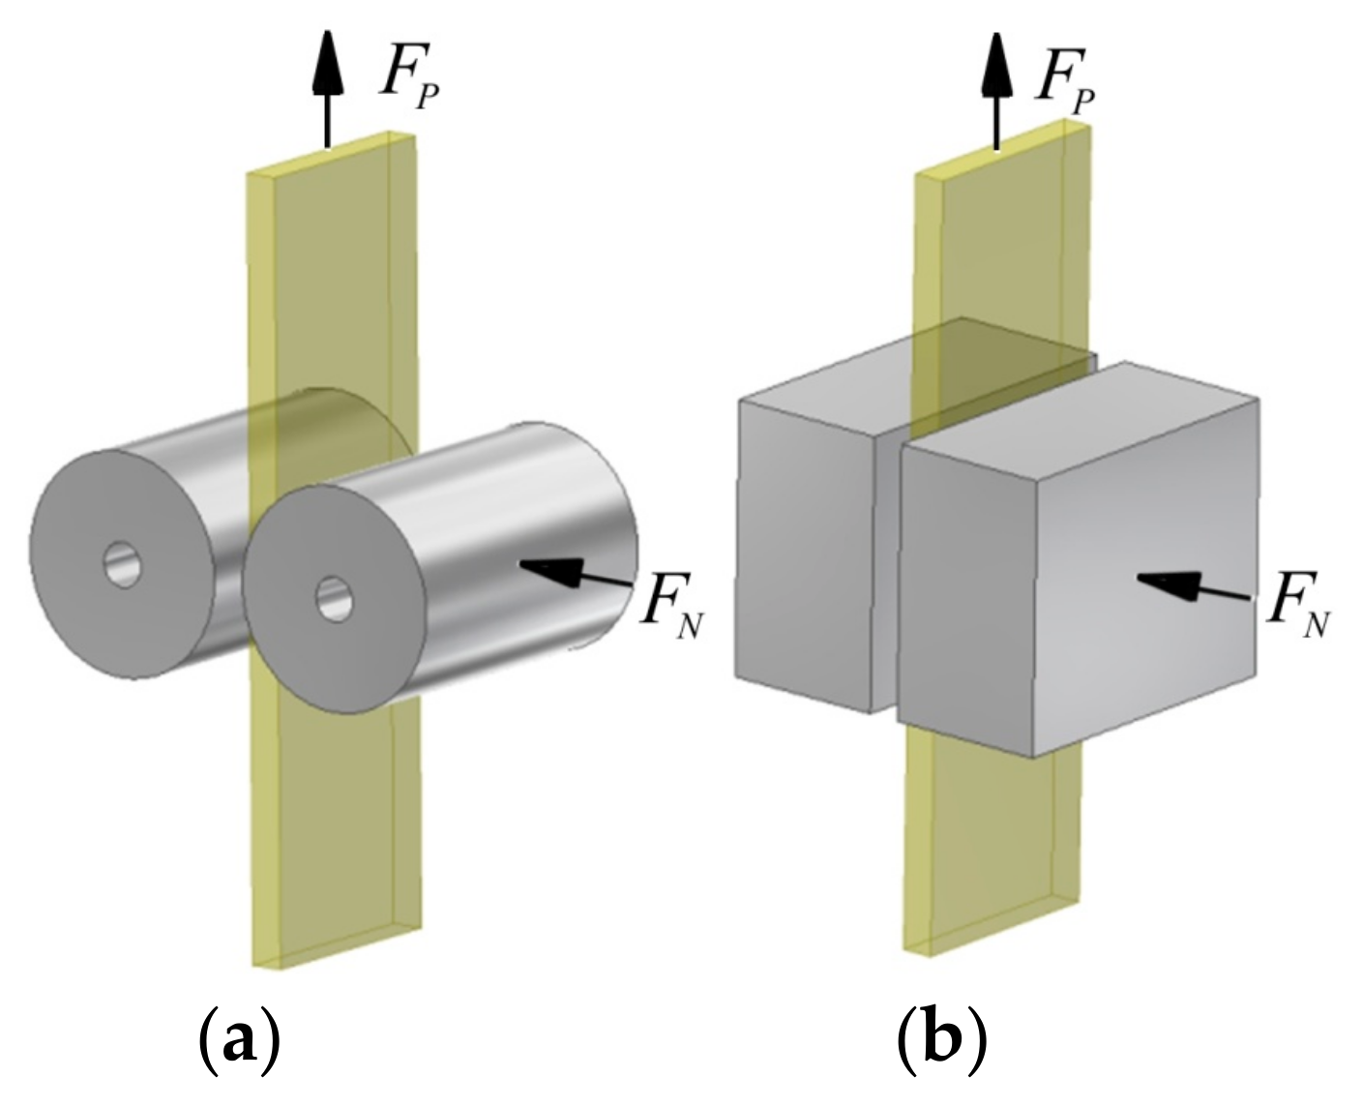
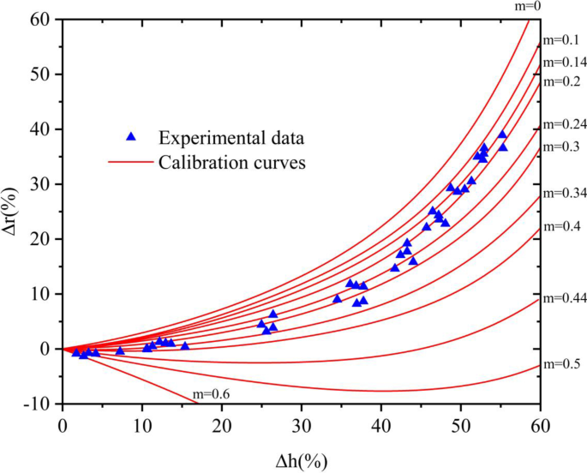
Abstract ID: Abstract Title
Author, Coauthor1, Coauthor2. Institute Name
This is the slide template for your Flash Talk
No animations or videos (this is a hard rule)
We suggest including the most important figures for your 3-minute talk (what do you want people to remember from that talk?)
Summarize the motivation and the major finding of your talk, so that people can ask questions even if they haven’t watched it already
This example is probably too wordy already – focus on the exciting figures and not bullet points

